Slide 1
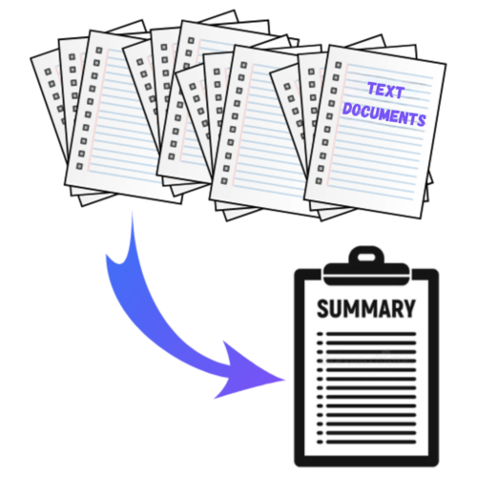
TEXT SUMMARIZATION PROJECT
Presented by: Akash Ilay

Slide 2
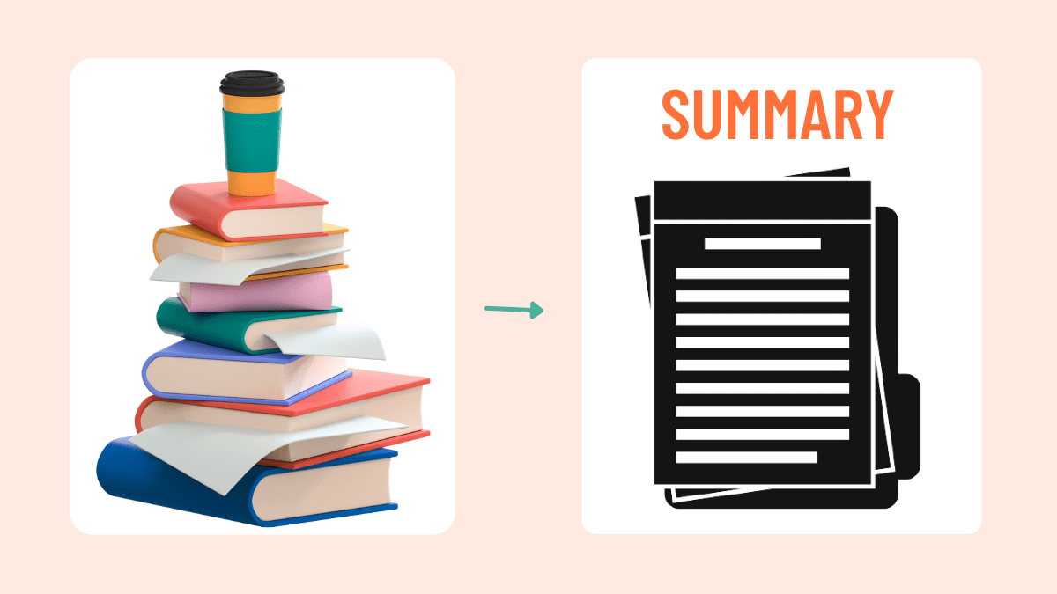
INTRODUCTION
Text summarization is the process of automatically condensing a large amount of textual data into a concise and coherent summary while retaining key information.
Importance:
Saves time by providing quick insights into large volumes of text.
Enhances information retrieval and decision-making processes.
Useful in various fields such as journalism, research, and business.
Applications:
News summarization
Document summarization
Summarizing research papers
Generating abstracts for academic articles
Summarizing customer reviews and feedback

Slide 3
PROBLEM STATEMENT
With the exponential growth of digital content, it becomes increasingly difficult to manually process and extract relevant information from large volumes of text. This necessitates the development of automated text summarization tools.
Aim: To create a tool that enhances information accessibility and usability by providing quick and accurate summaries, thereby saving time and aiding in better decision-making.
Objective: To develop an efficient text summarizer that can automatically generate concise and coherent summaries from longer text documents, preserving the essential information and meaning.

Slide 4

DATASET DESCRIPTION
Dataset: BBC News Articles
Source: Kaggle - The dataset was sourced from Kaggle, a popular platform for data science competitions and datasets.
Dataset Description: A collection of news articles published by the BBC. The dataset comprises a total of 2225 articles having five categories.
Business
Entertainment
Politics
Sports
Tech

Slide 5
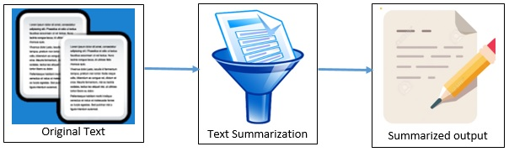
METHODOLOGY OVERVIEW
Data Preprocessing:
Text Cleaning
Tokenization
Feature Extraction
Summarization Techniques:
Extractive Summarization
Selects key phrases or sentences directly from the original text
Simple, faster to implement
May lack fluency and coherence
Abstractive Summarization
Generates a summary by rephrasing the content in a natural way
More fluent and coherent summaries
Requires more resources and training data

Slide 6
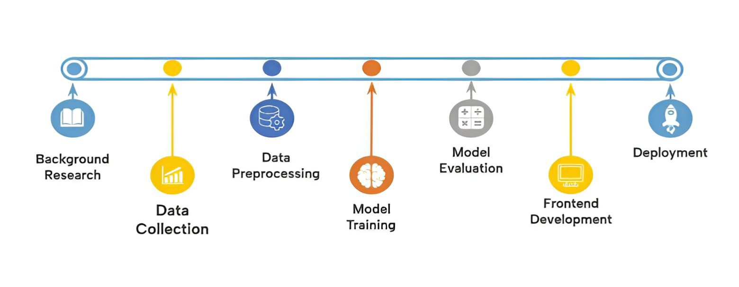
WORKFLOW OF THE PROJECT

Slide 7
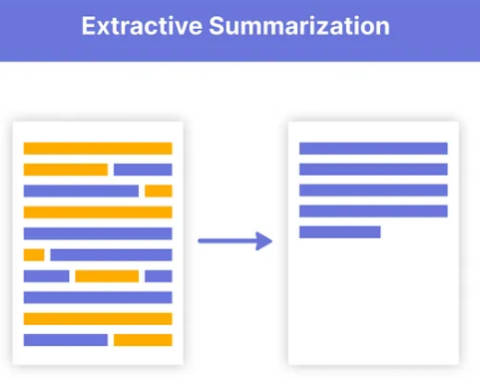
EXTRACTIVE SUMMARIZATION
Extractive summarization identifies the most relevant sentences or sections from the original text and combines them to form a summary.
It doesn't generate new sentences but rather "extracts" portions from the original content.
Utilized the pre-trained BERT Extractive Summarizer to identify and extract the most relevant sentences from the dataset.
Process:
Preprocessed the data (tokenization, stopword removal).
Used BERT’s contextual understanding to extract sentences.
Adjusted summary length with min_length and max_length parameters.

Slide 8
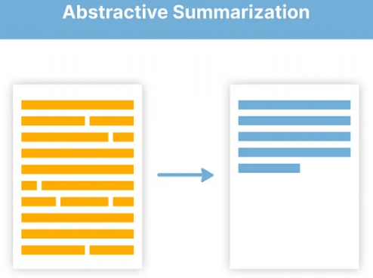
ABSTRACTIVE SUMMARIZATION
Generate concise and coherent summaries by rephrasing and restructuring the original text.
Utilized the pre-trained BART (Bidirectional and Auto-Regressive Transformers) model fine-tuned on the BBC News dataset for abstractive summarization.
Process:
Preprocessed the data (tokenization, stopword removal).
Input text passed through BART to generate rephrased summaries.
Fine-tuned BART on my dataset for improved contextual understanding and relevance.
Employs an encoder-decoder architecture:
Encoder: Understands the input text.
Decoder: Generates the summary based on the encoded understanding.

Slide 9
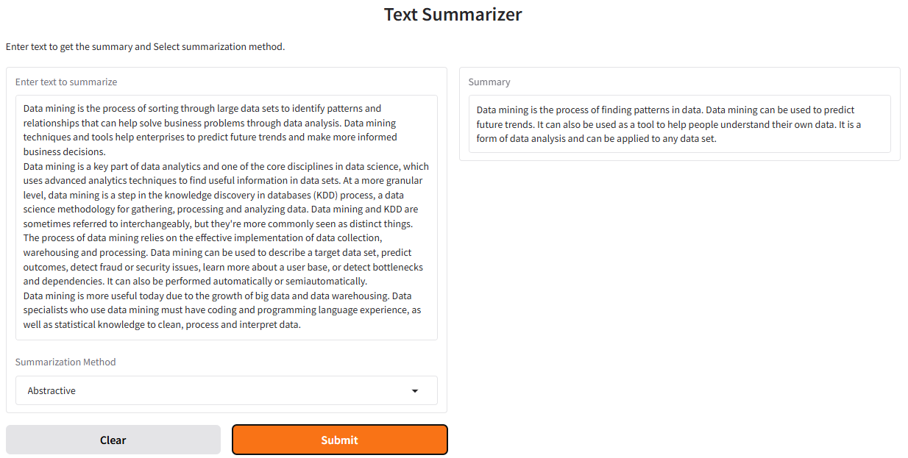
RESULT- Abstractive Summarizer

Slide 10

RESULT- Extractive Summarizer

Slide 11
CHALLENGES
High Computational Resource Requirements:
Summarization models, especially those based on deep learning, require significant computational power for training and inference.
Maintaining Semantic Coherence:
Ensuring that the generated summaries are not only grammatically correct but also semantically coherent and meaningful.
Training Time for Large Datasets:
Training summarization models on large datasets can be time-consuming.

Slide 12
KEY LEARNINGS
Understanding Text Summarization:
Gained insights into the different types of text summarization (extractive and abstractive) and their respective techniques.
Data Preprocessing Importance:
Learned the critical role of data preprocessing steps such as text cleaning, tokenization, and normalization in improving model performance.
Practical Applications:
Explored various practical applications of text summarization in fields like journalism, research, and business, highlighting its real-world relevance and impact.

Slide 13
FUTURE SCOPE
Real-time Summarization:
Enable real-time summarization for dynamic content such as live news feeds and social media.
Develop fast and efficient algorithms capable of processing and summarizing text in real-time.
Multilingual Summarization:
Extend summarization capabilities to multiple languages.
Train models on multilingual datasets and leverage transfer learning techniques.
User-Customizable Summaries:
Allow users to customize the length and focus of summaries based on their preferences.
Implement interactive summarization tools that let users specify summary parameters.

Slide 14
CONCLUSION
Text summarization is a crucial tool for managing and extracting information from large volumes of text.
There are two main types of summarization: extractive and abstractive, each with its own techniques and challenges.
The BBC news dataset provides a robust foundation for training and evaluating summarization models.
Key challenges include high computational resource requirements, maintaining semantic coherence, and long training times.

Slide 15
THANK YOU

